Slide 2
Lensed fiber (光纤透镜)
highpak.com
西安盛佳光电 (raysung.cn/cn/)
苏州波弗光电(bonphot.com)
IDIL
深圳艾孚光电

Slide 3
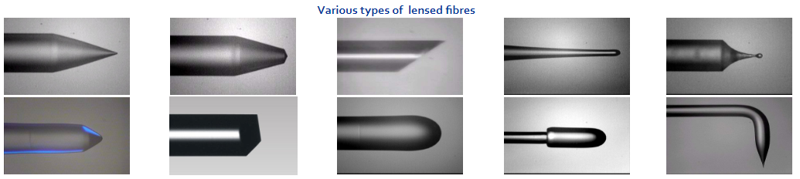
Highpak
highpak.com/fibre.html
Lensed fiber , lensed fiber assembly, and fiber array are available in single mode, PM fiber, D-shape fiber and multi mode fiber; in conical, wedge, angle and other customer tip shapes with/without AR coating

Slide 4
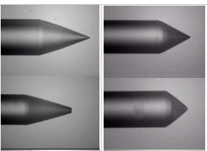
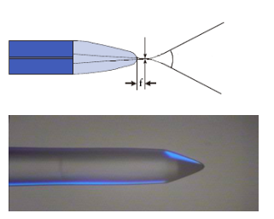
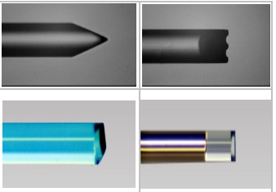
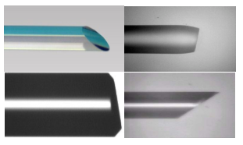
类别
Lensed Fibre / Metalized Fibre
Long-focus Lensed Fibre / Metalized Fibre
Cylindrical Lensed/Wedged Fibre
Angle Polished Fibre (0~10° or 30 - 50°)
highpak.com/fibre.html

Slide 5
可能需要提供的参数:
Wavelength, type of fiber, single more or multi-mode fiber? e.g. SFM-28,or PM1300, HI1060, etc. (波长, 光纤类型)
Type of lens: conical, wedge/cylindrical lens, or angled cylindrical lens, etc. (镜头类型)
Radius or lens, or far-field angle, or spot size. (半径或透镜, 远视场角, 光斑大小等光学参数)
Stripe length for lensed fiber, dimension of fiber assembly
Total length, connector, AR coating? (总长度等)
Quantity (数量)

Slide 6
西安盛佳光电
raysung.cn/
可以实现球形, 锥形, 楔形, 斜楔形, 斜面多种形状
对透镜的光斑, 远场等参数进行测试
额外: 金属化, 镀高反膜, FC封装, 加光纤光栅

Slide 7
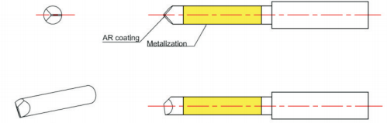
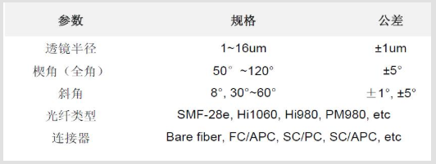
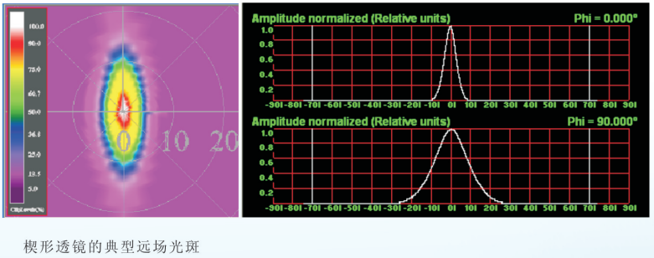
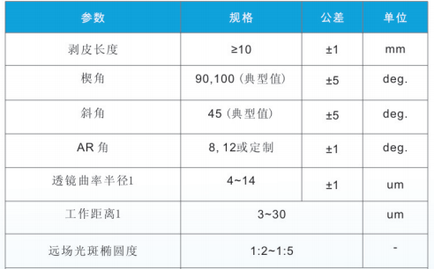
斜楔形光纤透镜
raysung.cn/

Slide 8
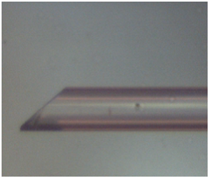
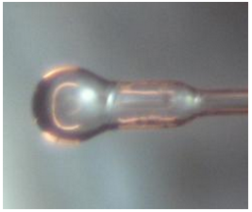
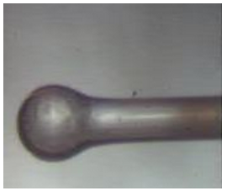
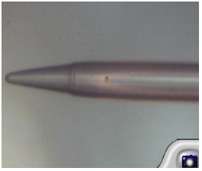
苏州波弗光电
http://www.bonphot.com/cp/html/?754.html
斜面光纤 (1)
大工作距离透镜光纤 (2) (3)
锥形透镜单模光纤 (4)

Slide 9
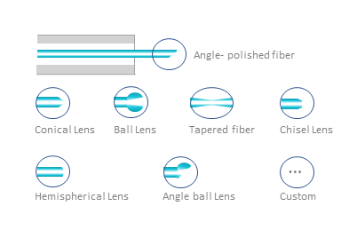
IDIL
https://www.idil-fibres-optiques.com/product/end-fiber-shaping/
angle polishing, angle lens (角型), conical lens (圆锥), conical lens with flat top, tapered lens, ball lens (球状), ball lens with large working distance, wedge angle (screw driver) lens (楔形), prism lens (棱镜), 8° to 45° face angle lens (面角镜), graded index(折射率渐变), cleave(劈开), splice (拼接) and others.

Slide 10
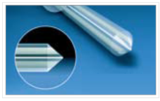
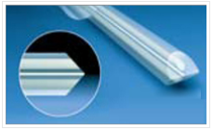
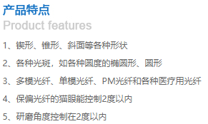
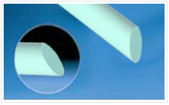
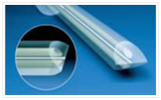
深圳艾孚光电
efprecise.com

Slide 11
神经网络典型值

Slide 12
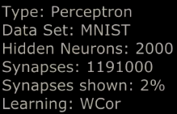
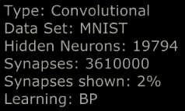
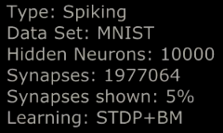

Slide 13
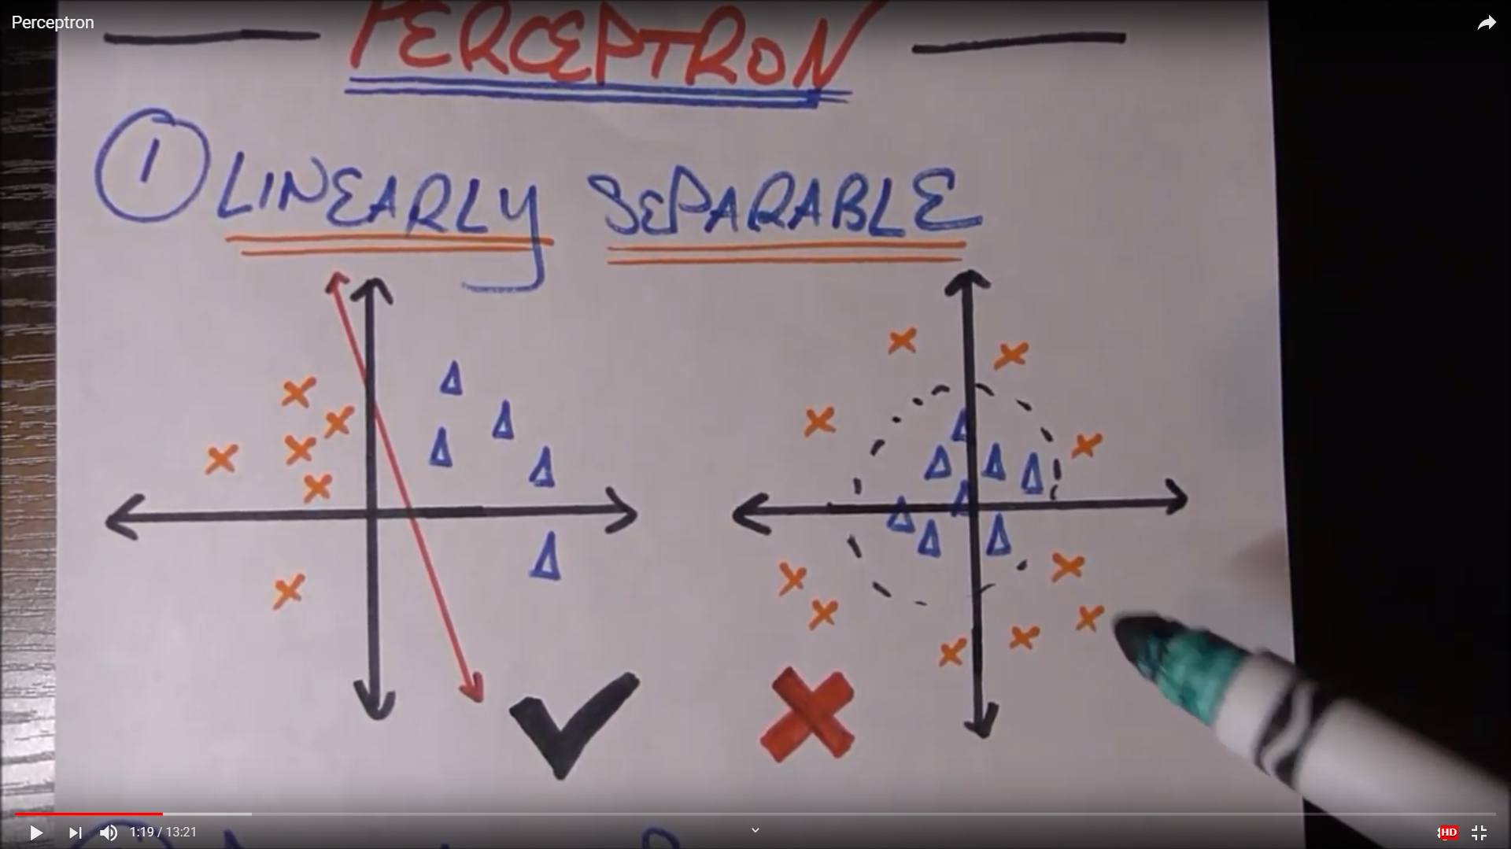
Perceptrons

